Slide 1
Angular Day6
Presented By : Asmaa Ahmed

Slide 2
Angular Forms
Template-driven
Easy to use
Two-way data binding -> Minimal component code
Automatically tracks form and
input element state
Reactive
More flexible ->
more complex scenarios
Immutable data model
Easier to perform an action on a value change
Easily add input elements dynamically Easier unit testing

Slide 3
State
Value Changed
Validity
Visited
pristine
valid
touched
dirty
invalid
untouched

Slide 4

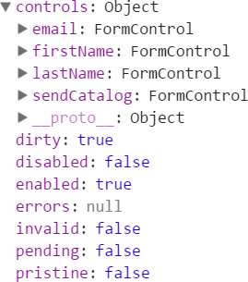

Template-driven Forms
Template
Form element
Input element(s)
Data binding
Validation rules (attributes)
Validation error messages
Form model automatically generated
Component Class
Properties for data binding (data model)
Methods for form operations, such as submit

Slide 5
Reactive Forms
Component Class
Form model
Validation rules
Validation error messages
Properties for managing data (data model)
Methods for form operations, such as submit
Template
Form element
Input element(s)
Binding to form model

Slide 6
Angular Forms
Template-driven
Generated form model HTML validation
Two-way data binding
Reactive
Manually created form model Validation in the class
No two-way data binding

Slide 7
Directives
Template-driven (FormsModule)
FormGroup
ngForm
ngModel
ngModelGroup
<form (ngSubmit)="save()">
</form>

Slide 8
Directives
Template-driven (FormsModule)
FormGroup
ngForm
ngModel
ngModelGroup
<form (ngSubmit)="save()" #signupForm="ngForm">
</form>

Slide 9
Directives
Template-driven (FormsModule)
FormGroup
ngForm
ngModel
ngModelGroup
<form (ngSubmit)="save()" #signupForm="ngForm">
<button type="submit"
[disabled]="!signupForm.valid">
Save
</button>
</form>

Slide 10
FormBuilder
Creates a form model from a configuration
Shortens boilerplate code Provided as a service

Slide 11

FormBuilder Steps
Inject the FormBuilder instance
Import FormBuilder
Use the instance
this.customerForm = this.fb.group({ firstName: null,
lastName: null, email: null, sendCatalog: true
});

